Slide 1
A survey on the impacts of technological change on training needs and on the usefulness of a
Personal Training Account
Conducted by Nanos for Senator Bellemare,
December 2019
Under embargo until February 6, 2020

Slide 2
The survey
Three themes
Theme 1: The perception of the impact of technological change on the labour market and the need for training
Theme 2: The perception of the skills gap and the need for training
Theme 3: The perception of the usefulness of personal training accounts and other topics

Slide 3
The survey
Methodology
Hybrid, random telephone and online survey of 1,010 Canadians, 18 years of age or older conducted between November 29-December 2, 2019
Participants recruited by telephone by live agents as part of an onmibus survey.

Slide 4
Theme 1: The perception of the impact of technological change on the labour market and the need for training

Slide 5
Question : According to experts, technological changes such as automation, artificial intelligence, online shopping and the sharing economy (e.g. UBER, Airbnb) could have significant impacts on the job market. To what extent do the following statements apply to you personally?
These changes threaten my job
These changes will affect my work tasks, and I will need training
[Only to employed respondents]

Slide 6
Canadians are twice as likely to say that technological changes to the job market will affect their work tasks and require training than to say these changes threaten their job.

Slide 7
17.7% of employed respondents think it is likely or somewhat likely that technological change will threaten their job. This represents an estimated 3.4 million Canadians.*
34.8% of employed respondents think it is likely or somewhat likely that technological change will affect their work tasks and that they will need training. This represents an estimated 6.6 million Canadians.
*All numbers are estimates made by transposing survey results on data from the Labour Force Survey.

Slide 8
Almost twice as many younger Canadians (18-34) are likely or somewhat likely to think that technological change will affect their work tasks compared to people 55 and older (43.4% vs. 22.1%).
Younger Canadians are also more likely to think that technological change will threaten their jobs than Canadians 35-54 who are the least likely to worry about it (21.1% vs. 15.2%), but the difference is not statistically significant.
Perceptions are not statistically different between men and women with respect to their jobs (18.1% vs. 17.3%) and tasks (36.5% vs. 32.7%).

Slide 9
Respondents in Quebec are the most likely to worry about their jobs (19.7%) and their tasks (38.2%) while those in Atlantic Canada are the least likely to worry about about their jobs (10.1%) and British Columbians worry the least about their tasks (23.3%).
Those with a high school diploma or less are the most worried about their jobs (27.8%) while those who had completed graduate studies are the least worried (9.5%).
Those who have completed university studies are the most likely to think their tasks will be affected (38.5%) while those who have completed college are the least likely to think their tasks will be affected (27.4%).

Slide 10
Theme 2: The perception of the skills gap and the need for training

Slide 11
Question : Which statement best describes your situation?
I have all the training I need
I would be interested in taking training
I would be interested in taking training, but I do not have time for it
I would be interested in taking training, but I cannot afford it
I do not want training
I don’t know
[To all respondents from here]

Slide 12
More than half of Canadians and nearly two thirds of the labour force report an interest in training.

Slide 13
Most Canadians are interested in training
56.4% of respondents, an estimated 11.4 million* of active Canadians, are interested in training.
Among those interested, 40.4% of respondents, an estimated 4.6 million of active Canadians, cannot afford training (24.3%) or have no time for it (16.1%).
*All numbers are estimates made by transposing survey results on data from the Labour Force Survey on the total labour force, which gives a minimum value.

Slide 14
Younger Canadians (18-34) are more than twice as interested in training than Canadians 55 and older (74.4% vs. 32.7%)
Among those uninterested in training, two-thirds were 55 or older.
Men were more likely to say that they have all the training they need or that they do not want training (39.1%) than women (33.6%).*
* Marginally not statistically different

Slide 15
Interest for training is highest in the Prairies (64.1%) and lowest in Quebec (49.2%).
Those with a high school diploma or less are the least interested in training (53.8%) while those who had completed graduate studies are the most interested (62.3%).

Slide 16
Interest in training is the lowest (34.0%) for those not in the labour force.
Full-time employed workers and unemployed workers report the same level of interest in training (65.4% vs. 64.2%)
But 72% of those unemployed who are interested in training cannot afford it vs. 20% of those who are employed full time.

Slide 17
Question : To what extent do you agree or disagree with the following statements?
I should take training to improve my reading ability.
I should take training to improve my math skills.
I should take training to improve my computer skills (e.g. using Internet tools).
I should take training to improve my occupational skills.
I need a skills assessment to better identify my training needs.
[RANDOMIZE]

Slide 18
Millions of Canadians consider that they need to upgrade some essential skills, notably their computer skills.

Slide 19
10.5% of respondents, an estimated 2.1 million active Canadians, agree or somewhat agree that they should take training to improve their reading abilities.
26.4% of respondents, an estimated 5.4 million active Canadians, agree or somewhat agree that they should take training to improve their math skills.
48.4 % of respondents, an estimated 9.8 million active Canadians, agree or somewhat agree that they should take training to improve their computer skills.

Slide 20
46.3% of respondents, an estimated 9.4 million active Canadians, agree or somewhat agree that they should take training to upgrade their occupational skills.
28.9% of respondents, an estimated 5.9 million active Canadians, agree or somewhat agree that they need a skills assessment.

Slide 21
Some differences between age groups are not statistically significant :
Younger Canadians (18-34) are most likely to think that they should take more training for literacy (15.1%), math skills (38.3%), and occupational skills (66.1%) and that they need a skills assessment (41.5%).
Those 55 and over are most likely to think that they should take more training to improve their computer skills (50.4%) while younger Canadians are less likely to identify a need to improve computer skills (45.2%).

Slide 22
There is no statistically significant difference between women and men regarding reading skills (9.7% vs. 11.2% ).
Women are more likely to think that they should take training to improve their math skills (30.3% vs. 23%) and computer skills (52.1% vs. 45%), but these differences are not statistically significant.

Slide 23
Regional differences of training priorities among respondents:
Improving reading skills is the highest in Atlantic Canada (16.4%) and the lowest in Ontario (9.3%).
Improving math skills is also the highest in Atlantic Canada (32.6%) and the lowest in Quebec (20.9%).
Improving computer skills is the highest in British Columbia (54.7%) and the lowest in Quebec (43.3%).

Slide 24
Interest in training to improve occupational skills is the highest in the Prairies (49.6%) and the lowest in Atlantic Canada (40,8%).
Those with a high school diploma or less are the most interested in training to improve reading skills (14.9%), math skills (39.1%) and computer skills (56.5%).
Those who had completed university studies are the least interested in training to improve their reading skills (7.9%) and computer skills (44.2%).
Those who had completed graduate studies are the least interested in training to improve math skills (20.9%).

Slide 25
Some differences between education levels are not statistically significant :
Those with a high school diploma or less are the least interested in training to improve their occupational skills (44.2%), while those who had some college or university are the most interested in training (50.6%).
Interest for skills assessment is highest among those with some college or university (32.5%) and lowest for those who have completed university studies (27.5%).

Slide 26
Theme 3: The perception of the usefulness of personal training accounts and other topics

Slide 27
Question : Let’s suppose that the government created a personal training account in your name to help you save money for training. This would be like a Registered Education Savings Plan (RESP), but for your training. To what extent would you agree or disagree with the following statements?
I would be more interested in taking training
I would make financial contributions to my personal training account
I would be more interested in taking training if the government topped up my contribution by depositing funds into my personal training account.
I would be even more interested in taking training if my employer topped up my contribution and that of the government by depositing funds into my personal training account.

Slide 28
A majority of respondents believe that a Personal Training Account would be useful to increase training
53.1% of respondents, an estimated 10.8 million active Canadians, agree or somewhat agree that they would be more interested in training if they had a Personal Training Account (PTA).
55% of respondents, an estimated 11.2 million active Canadians, would be more interested in taking training if the government topped up their contribution.
54.7% of respondents, an estimated 11.1 million active Canadians, agree or somewhat agree that they would be even more interested in taking training if their employer and the government topped up their contribution.

Slide 29
Younger Canadians (18- 34) are most likely to be interested in training with a PTA (69.4%).
Those in the 55 plus age group are the least likely to be interested in training with a PTA (30.8%).
Women are more likely to be interested in training with a PTA than men (57.9% vs. 48.7%).

Slide 30
Interest in training with a PTA is highest in the Prairies (56.3%) and lowest in British Columbia (47.5%).
Those with a high school diploma or less are least likely to be interested in training with a PTA (49.5%) while those who have completed university studies (58.5%) are most likely to be interested in training with a PTA.

Slide 31
Many Canadians would likely contribute to a Personal Training Account
40.5% of respondents, an estimated 8.2 million active Canadians, agree or somewhat agree that they would make financial contributions to a Personal Training Account.

Slide 32
Contribution to a Personal Training Account (PTA)
Younger Canadians (18-34) are most likely to make financial contributions to a PTA (51.8%) while those in the 55 plus age group are least likely (25.1%).
Women are more likely to make financial contributions to a PTA than men (42.6% vs 38.6%).

Slide 33
Contribution to a Personal Training Account
Interest in contributing to a PTA is highest in Quebec (44.5%) and lowest in Atlantic Canada (37.4%).
Those who have completed college have the highest interest in contributing to a PTA (43.9%) while those who have completed university studies are the least likely to contribute to a PTA (38.5%)
but those differences are not statistically significant.

Slide 34
Question : Which of the following items should a personal training account funded by you, the government and your employer pay for to help you take training? (Select all that apply)
Fees for any post-secondary training of my choosing
Fees for training related to labour market needs
Fees for training identified by my employer
A personalized skills assessment
Direct training expenses (textbooks, educational materials, notebooks, and so on)
Related expenses such as transportation and child care (please specify) . [RANDOMIZE]

Slide 35
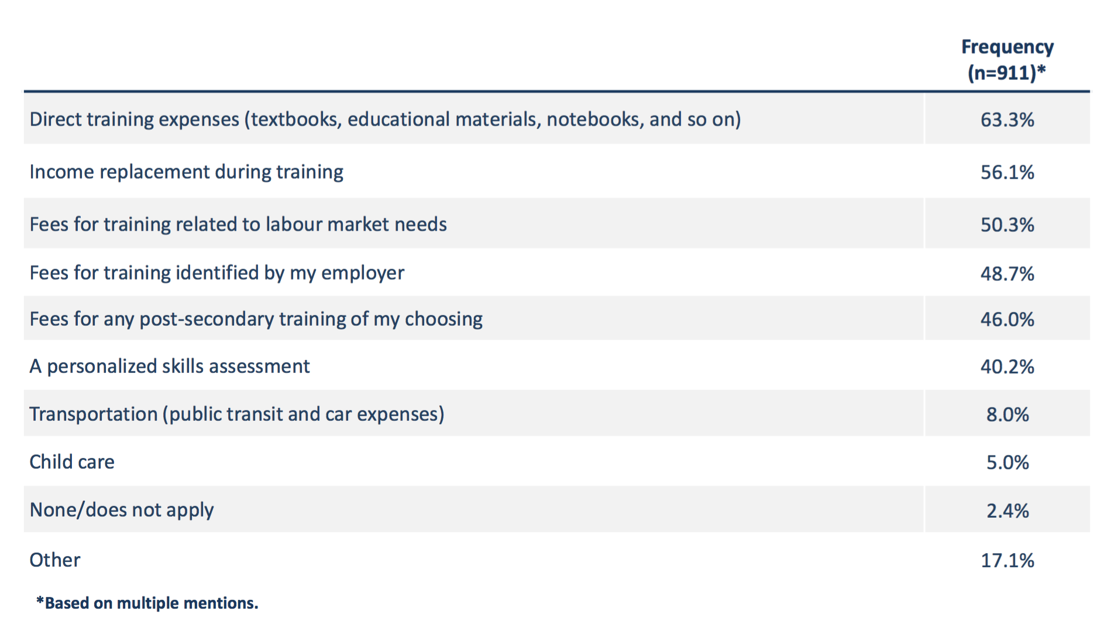
A Personal Training Account should cover a large array of training expenses

Slide 36
Question : If you had to choose a new employer, to what extent would the employer’s support for your training and skills acquisition positively influence your decision?
It would very much positively influence my decision.
It would somewhat positively influence my decision
It would not positively influence my decision at all
Unsure

Slide 37
Employer’s support for training influences decisions of a very large majority of active Canadians when choosing a new employer
73.7% of respondents, an estimated 15 million active Canadians, say employers’ support for training would very much (41%) or somewhat (33%) positively influence their decision making when choosing a new employer.
Only 12.4% say employers’ support would not positively influence their decision.

Slide 38
A survey of Canadians on the impacts of technological changes, their training needs and the usefulness of a
Personal Training Account
Appendices

Slide 39
CANADIANS' PERCEPTIONS ON VARIOUS CURRENT AFFAIRS TOPICS MARCH 2014, Done for Sen. Bellemare, Senate of Canada

Slide 40
CANADIANS' PERCEPTIONS ON VARIOUS CURRENT AFFAIRS TOPICS MARCH 2014, Done for Sen. Bellemare, Senate of Canada

